Slide 1

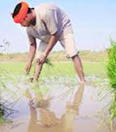
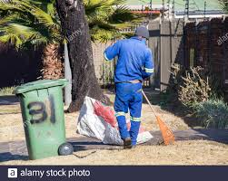
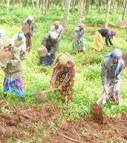
ULHS

Slide 2
INTRODUCTION
ULHS or Unskilled Labour Hire system is a website which help people for hiring unskilled workers for different services like cleaning the surroundings, farming, ploughing,etc.
This will help customers to easily find workers who are willing to do any work.
It also help workers to find their works easy.

Slide 3
UNSKILLED LABOUR HIRE SYSTEM
Admin
Supervisor
Worker
Customer
MODULES

Slide 4
ADMIN
Login
View booking and its details
Contact supervisor
Assigning a supervisor for each work
Approval of registration
Contact customers

Slide 5
SUPERVISOR
Registration facility
Login
View detail of hired works
Assigning a team of workers
Contact workers

Slide 6
WORKER
Registration facility
View details of assigned work
Login
Contact supervisor

Slide 7
CUSTOMER
Book services
Contact supervisor
View profiles of workers and supervisor
Give feedback
View details and progress of booking
Registration facility
Login

Slide 8
EXISTING SYSTEM
There isn't any automated system yet.
People is hiring unskilled labours by contact them directly.
They have to search for the laborer contact by asking people around them

Slide 9
ADVANTAGES
No need of techonology knowledge
Can contact them directly
Can hire same laborer again and again

Slide 10
DISADVANTAGES
The same laborer may not be available everytime
Can't trust laborers
They aren't supervised by anyone

Slide 11
PROPOSED SYSTEM
Workers who are willing to do anytype of works can find work easily.
Customers can find unskilled labours for one day work or work that last for fixed period of time.

Slide 12
ADVANTAGES
Customers get workers who are willing to do anytype of work
Customer is provided with workers details and id proof number
Customers doesn't have to take supervising responsibility
Workers are provided with works most of the time

Slide 13
DISADVANTAGES
Time consuming compared to existing system
Should have knowledge about technology
There is chance of not getting the exact number of workers that the customer requested
Can’t provide immediate service

